Slide 1
The Massachusetts Vocational Teacher Licensure Process
The following presentation will explain How to become a preliminary, Chapter 74 Vocational Technical Teacher

Slide 2
About the Presenter
Jarrod Lussier of Fairhaven, Ma. I am a class of 2000 Plumbing graduate of Greater New Bedford Voc-Tech in New Bedford, Ma
I currently hold the following Ch. 74 licenses:
Superintendent/ Assistant Superintendent Principal/ Assistant Principal Vocational Director
Cooperative Education Coordinator Plumbing Instructor
I am currently an administrator at Greater New Bedford Voc Tech. I am in my 2nd year with the district in the role of Academy Administrator, and my first year as the Technical Institute Director.
Previously, I served as a Chapter 74 plumbing instructor at Southeastern Regional Vocational High School in Easton, Ma where I taught for 8 years. I then transitioned to administration and served as a Vocational Supervisor for 1 year.
I am offering this presentation on my own behalf and not as a representative of either district.

Slide 3
What is chapter 74 vocational education?
Chapter 74-approved vocational technical education programs are programs that meet the definition of vocational technical education contained in Massachusetts General Law Chapter 74.
Districts apply for program approval to Department of Elementary and Secondary Education’s (DESE) Office for College, Career, and Technical Education (OCCTE) pursuant to Chapter 74 and the Vocational Technical Education Regulations.

Slide 4
New Name, Same Meaning
Vocational Education has been referred to, more and more, as Career Vocational and Technical Education (CVTE). In the event you see a link or page referencing CVTE, it is the same as vocational.

Slide 5
How Many Vocational and Chapter 74 Schools are there in Massachusetts?
As of 2021, there are 39 Vocational High Schools in Massachusetts
There are also dozens of comprehensive high schools; New Bedford High, Durfee High, Taunton High, Brockton High, and more, that offer approved Chapter 74 Vocational Programs.
Employment Opportunities can be found on School Spring.

Slide 6
What grades can I teach with my license(s)?
As a Chapter 74 teacher, your initial license is listed as 9 – 14, preliminary
This means you can teach at the Secondary level (grades 9 – 12, high school)
You can also teach at the Post-Secondary level (Technical Institute/ post-graduate level)

Slide 7
How do I become licensed?
Step 1 What License do I need?
Every vocational (CVTE) teacher must first obtain a preliminary license. The Chapter 74 Guide for Preliminary Vocational Technical Teacher Licensure is listed on the Department of Elementary and secondary Education’s (DESE) website.
How do I find the license I need?
Using this guide, you will learn how to find the license that aligns to your work experience and what the specific requirements are.

Slide 8
my experience aligns with becoming a Ch. 74 teacher, Now What?
Setting up and using an ELAR account
The first step for any individual looking to earn a Massachusetts Educator License is to create an ELAR account. The Educator Licensing and Renewal (ELAR) system is the online licensing system used by the Office of Educator Licensure to track the Licensure process for all applicants.
Educators are encouraged to set up their own ELAR account so that they can easily access their information by recalling their username and password. Click here to create your own.

Slide 9
EXample ELAr Profile

Slide 10
What are the basics?
Almost all Chapter 74 CVTE licenses require a minimum of 3-5 years in the field/workforce that aligns to that license. More so, many require specific licenses, certifications, a degree, or depending on the field, all of the above; e.g.
Plumbing – 5 years of full-time employment in the trade, Master Plumbing License
Carpentry – 5 years of full-time employment in the trade, construction Supervisor’s License
Business Technology – 4 years of full-time employment in the field, Associate degree or higher degree related to the subject matter and skills to be taught.
A passing score on both the Vocational Literacy Skills and Communication and Literacy Skills exams (VTELS) is required.
Also, a passing score on both a written and performance exam in your field is required.

Slide 11
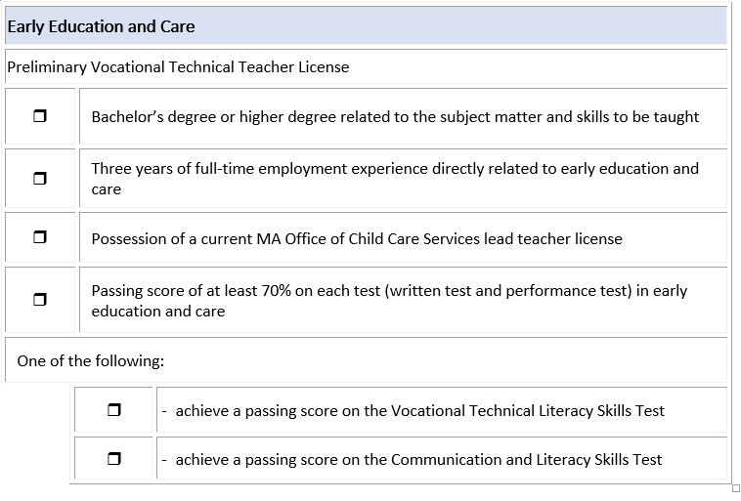
It’s Essentially 4-5 tests, plus your current Licensing
Here’s an example from the Ch. 74 Guide

Slide 12
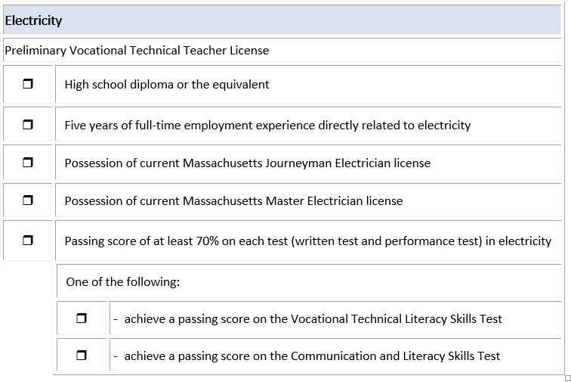
It’s Essentially 4-5 tests, plus your current Licensing
Here’s an example from the Ch. 74 Guide

Slide 13
What are the Vocational Technical Literacy Skills Test (VTELS)?
On the website for registration, you will see MTEL for Massachusetts Tests for Educator’s Licensure. This is the correct page. When registering for the exams, make sure you choose Vocational Technical Literacy Skills Test (91). *These are the VTELS
There are MTEL exams and VTEL exams. MTELS are a higher content area and are designed for academic teachers and administrative licenses.
In the event you take the MTEL exams, it covers the requirements for the VTELS

Slide 14
MA Vocational Teacher Testing Program
The MA Vocational Teacher Testing Program is administered through Greater Lowell Technical High School. To date, this is the only location for both the written and performance exams. Registration, handbooks, outlines, resources, are all available through their website.
Registration is only done by mail with a money order. They do not have online registration.
First you must pass the written exam in your content area; e.g. if your field is plumbing, you must pass the written plumbing exam to become eligible for the practical exam. If you field is hospitality, you must pass the hospitality written exam, and so on.

Slide 15
MA Vocational Teacher Testing Program continued
Candidates must pass the written examination with a score of 70% or above before registering for the performance exam.
Once you pass the written exam you will be mailed a performance exam registration form.
If you need a performance exam registration form please contact the Testing Program Office.
For questions, please contact Lisa Boyd at lboyd@gltech.org
You can also follow them on Twitter @MATeacherTest

Slide 16
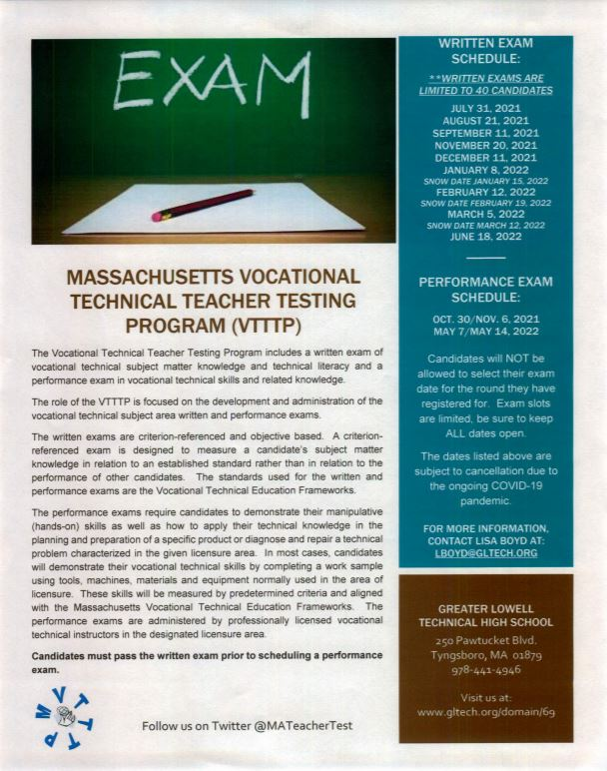

Slide 17
Summary: What you Need
The education requirement (i.e. bachelor’s degree, associate degree or high school diploma)
The employment experience requirement
The occupational license requirement
Achieving a passing score on the subject specific written and performance exams and
Achieving a passing score on one of the literacy skills VTEL’s or MTELs.

Slide 18
Questions
Please feel free to reach out to me if you have any further questions.
Email: jrlussier82@gmail.com

